Slide 1







Tools You’ll Need Today:
In your browser go to: thimble.webmaker.org
connect to wifi:
network:
password:

Slide 2
Your Lead Instructor
Who am I?
Picture ☺
I do….
I like…
When I grow up, I want to be….

Slide 3
Ice Breaker: Let’s get to know each other!

Slide 4
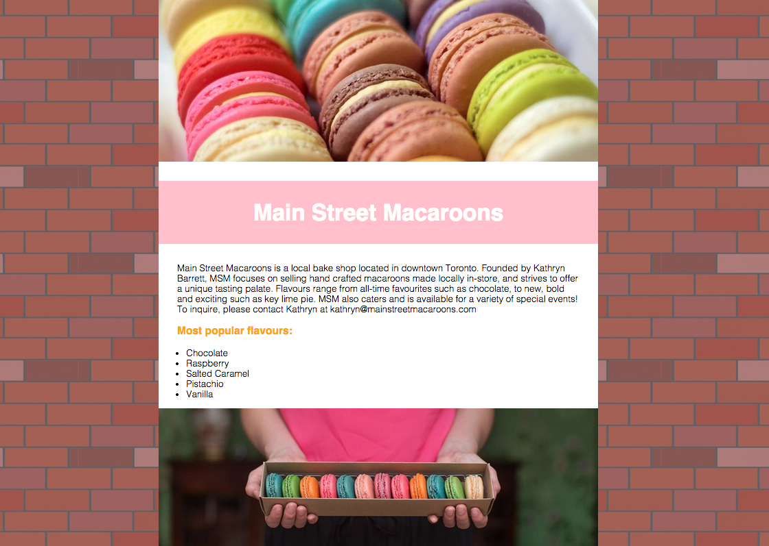
Today’s project
A business webpage coded from scratch!
Notes:
Project example: https://klc-workshops.makes.org/thimble/MTMzMTk1MzkyMA==/main-street-macaroons
What KLC provides
Looking forward

Slide 5
Agenda
Morning (11:00am-12:30pm):
What makes a good website?
How to read and write in HTML
Afternoon (1:00pm-4:00pm):
How to read and write in CSS
More HTML
More CSS
Final touches and demos!

Slide 6
Why do we make websites?

Slide 7
What makes a good website?

Slide 8
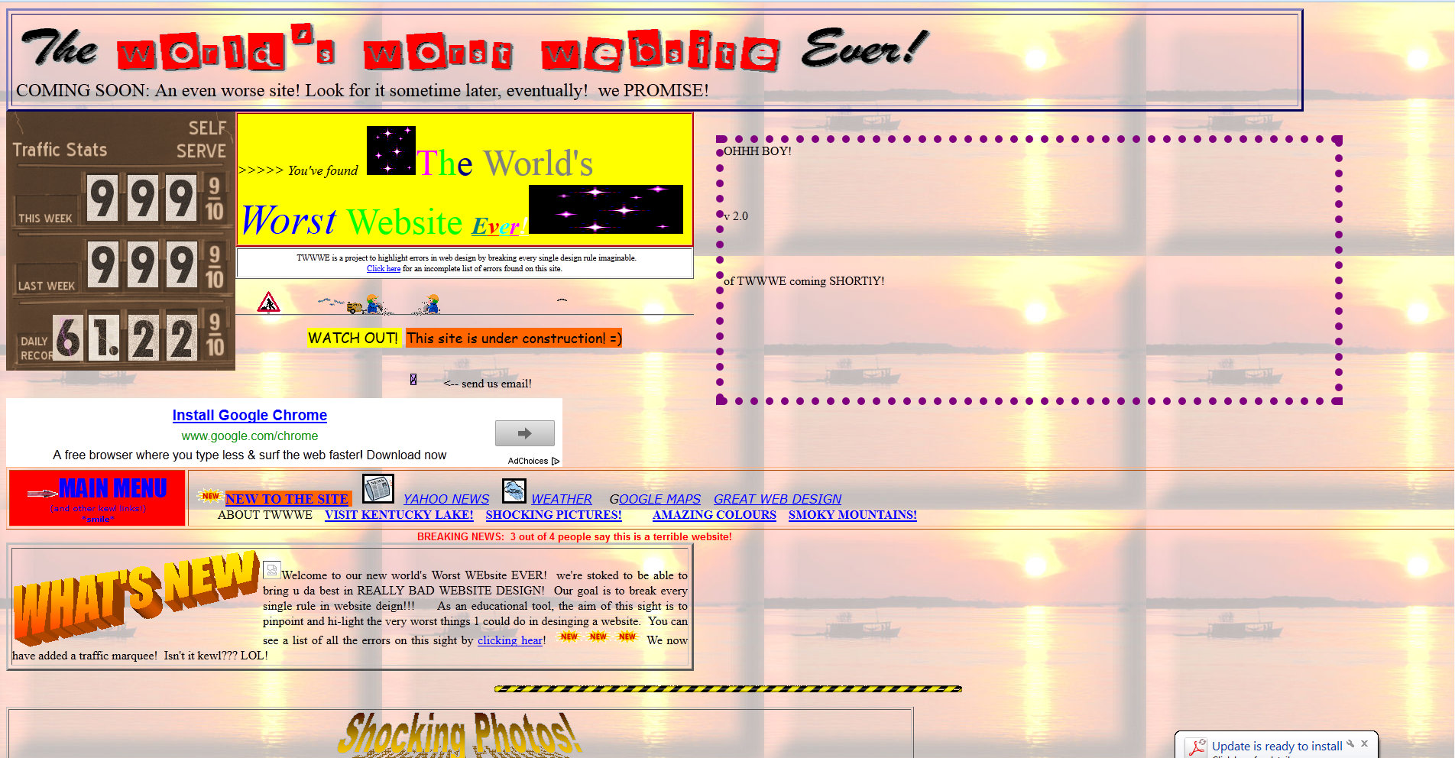

Slide 9
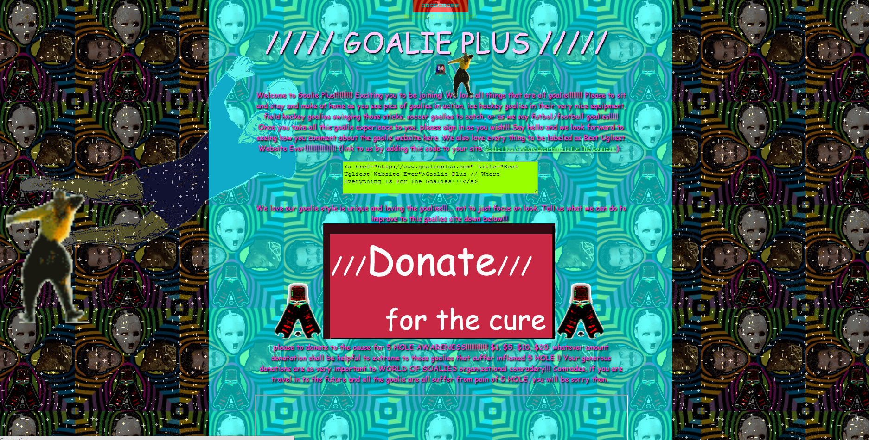

Slide 10


Slide 11
Good design is...
Easy to read
Easy to understand
Easy on the eyes

Slide 12

How is a website made?
Draw it on a piece of paper and take a photo
Use a writing program like Microsoft Word
Yell at the computer until it makes a website
Write code

Slide 13
Websites are made using CODE!

Slide 14
What does code look like?

Slide 15
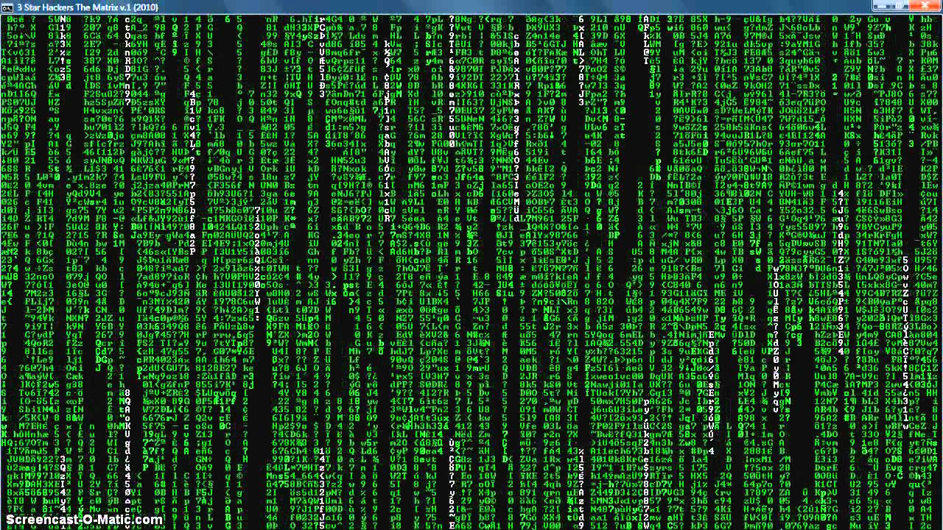
???

Slide 16
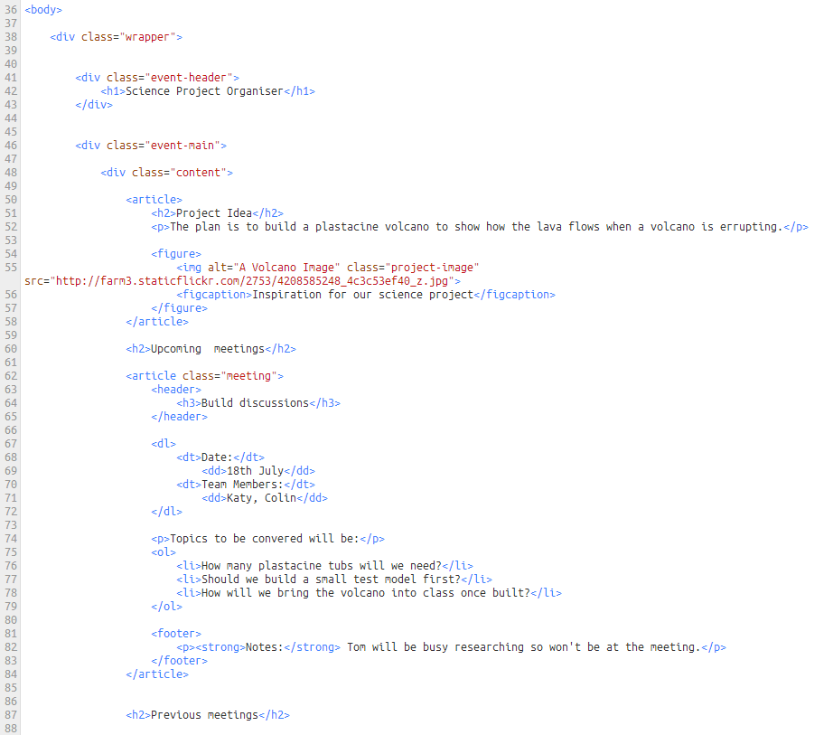

Slide 17
Today, we’re coding in HTML!
The webpage language.

Slide 18

Browsers
They show us websites
They don’t understand English, but they do understand HTML

Slide 19
HTML: hyper text markup language
Remember: we use HTML to communicate with our browsers
When we use HTML, we are telling our browser information about our webpage and what kind of content to display

Slide 20
So… how do we read and write HTML?

Slide 21
HTML is made up of elements
<p>This is a paragraph of text.</p>
element

Slide 22
We use tags to make elements
<p>This is a paragraph of text.</p>
opening tag closing tag
what’s the main difference between the two?

Slide 23
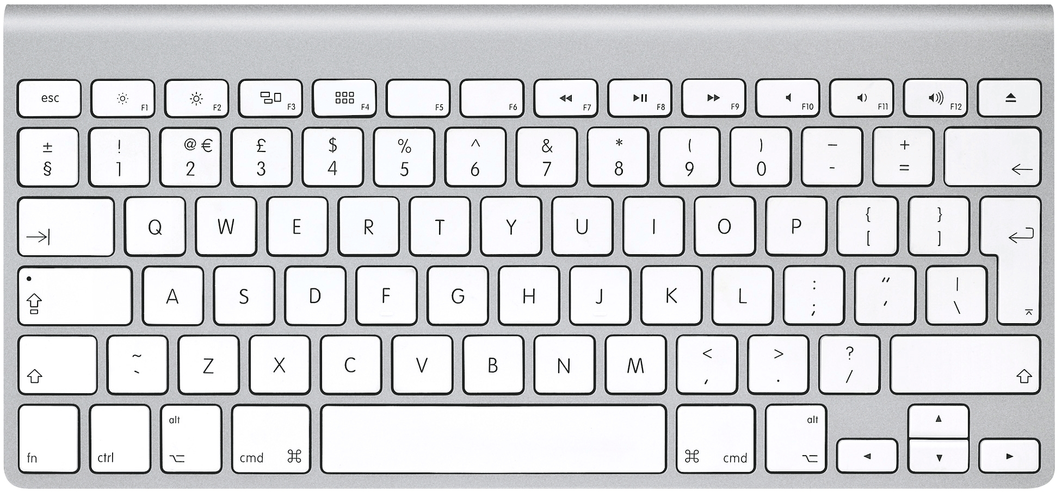
Tags use < and > and /

Slide 24


Tags always come in pairs
<p>This is a paragraph of text.</p> =
<p>This is a paragraph of text. =

Slide 25
Understanding a basic HTML file
<html>
<head>
</head>
<body>
</body>
</html>
We’re going to start communicating in HTML
Information about our webpage starts here
Information about our website ends here
Content to display starts here
Content to display ends here
We’re going to stop communicating in HTML

Slide 26
Remember: Tags have to be perfect
<p>This is a paragraph of text.</p>
opening tag closing tag

Slide 27
Is this right?
<p>This is a paragraph of text.<p>

Slide 28
Is this right?
<p>This is a paragraph of text.

Slide 29
Is this right?
p>This is a paragraph of text.</p>

Slide 30
Is this right?
<p>This is a paragraph of text.</b>

Slide 31
Ready to start coding?!

Slide 32
Today, we’re using a tool called Mozilla Thimble

Slide 33
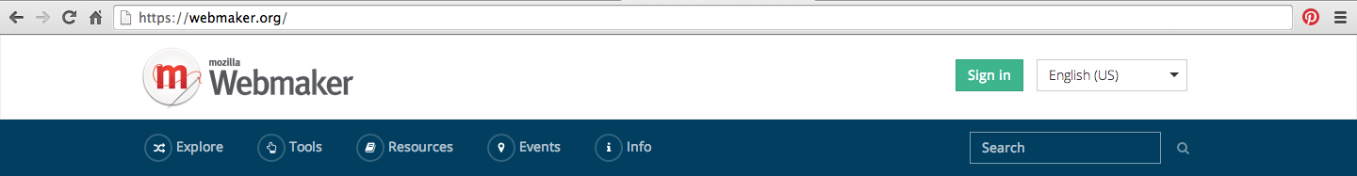
webmaker.org
email: workshops@kidslearningcode.com
password: helloworld123
→ Choose to ‘login with Persona’

Slide 34
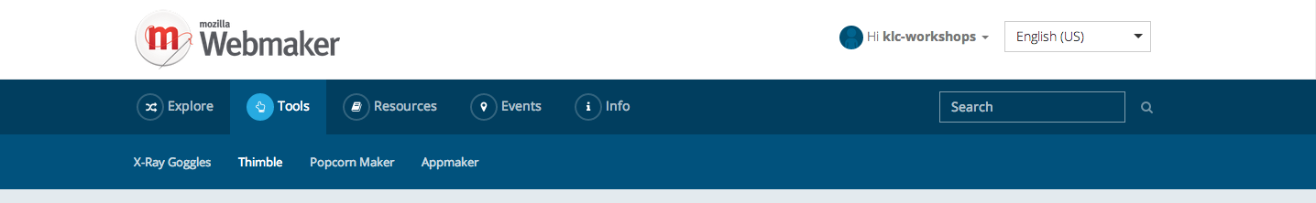
webmaker.org

Slide 35
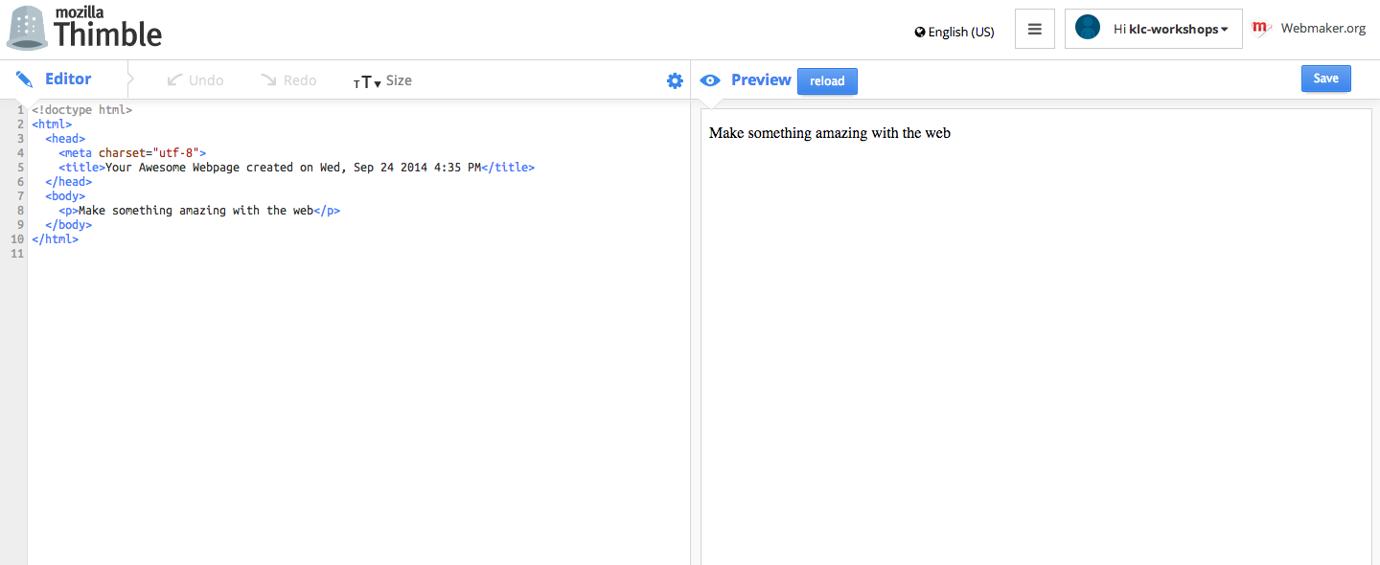
Nesting
Look at all the tags Thimble gives you!
Which ones do you recognize?
Look closely, and you’ll see that there are tags inside other tags
This is called nesting
Which tags are being
nested?

Slide 36
<head> </head>
Head tags hold information about our webpage
Nested inside the head tags are title tags
A title refers to the text you see at the top of a webpage, in a tab, or even in Google search result

Slide 37
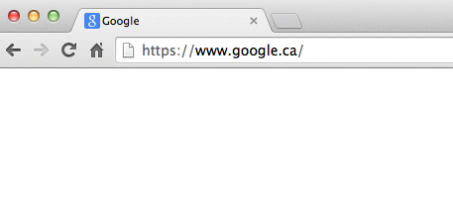
<title> </title>
<title>Google</title>
Notes:
Now write your own title - 5 minutes

Slide 38
<body> </body>
Body tags hold your webpage’s content
What is nested inside your body tags already?
What other pieces of content could you put on a webpage?
Notes:
Answer: pictures, videos, sound clips, links, headlines

Slide 39
headings
Heading tags come in 6 different types
<h1> Heading 1 </h1>
<h2> Heading 2 </h2>
<h3> Heading 3 </h3>
<h4> Heading 4 </h4>
<h5> Heading 5 </h5>
<h6> Heading 6 </h6>
Notes:
Now write your own heading - 5 minutes

Slide 40
Links - Tags with attributes
The <a> tag (anchor), tells a browser to link to another webpage. But how does it know what URL to link to?!
We need to tell the browser more information - to do this, we use an attribute

Slide 41
Links
<a href=“http://www.google.ca”>Google</a>
opening tag attribute value closing tag

Slide 42
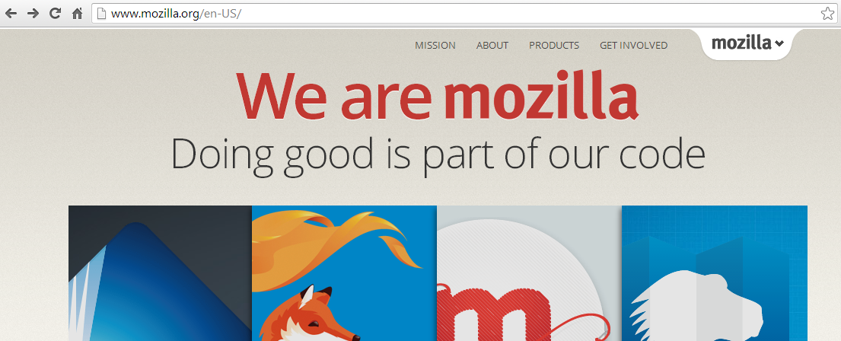
How do I get a link URL?
Copy this

Slide 43
Images
An image attribute tells the browser where to find the image
<img src=“http://www.hello.com/cat.jpg”/>
opening tag attribute value closing tag

Slide 44
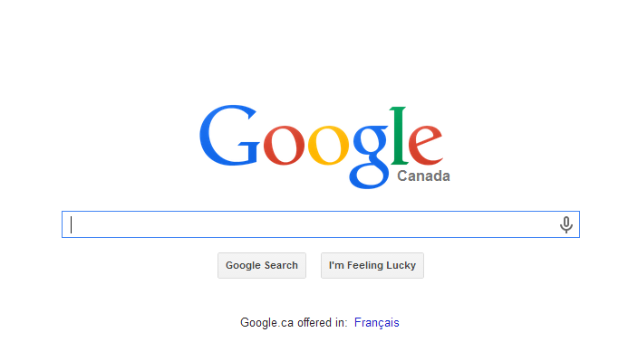
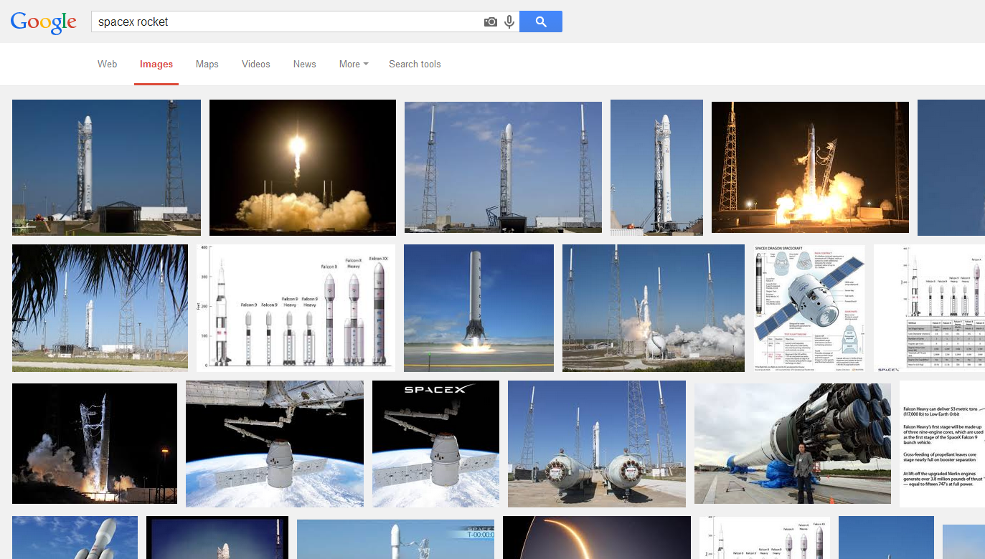
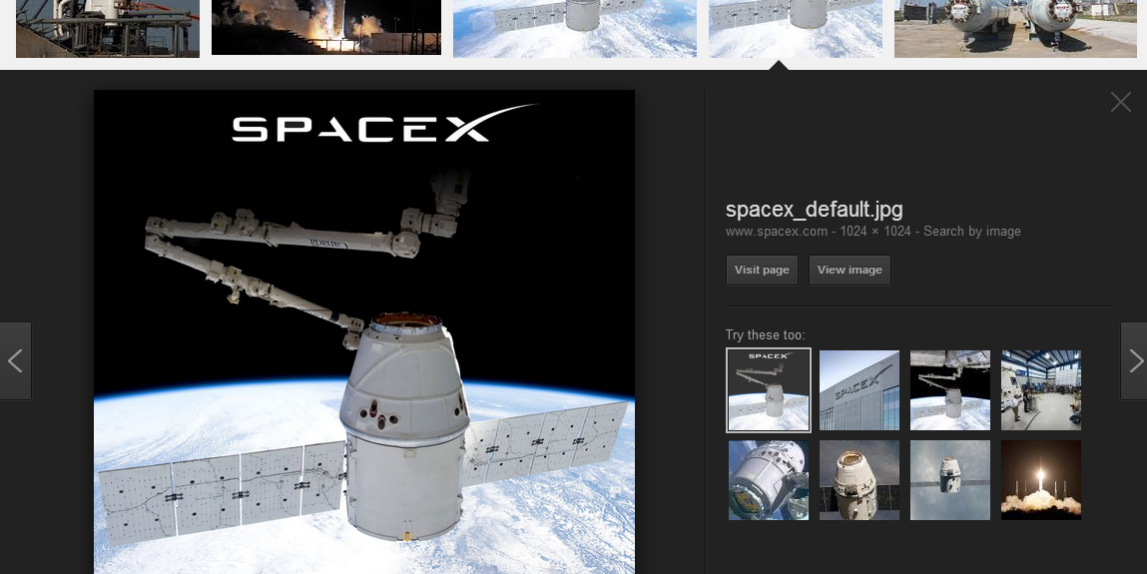
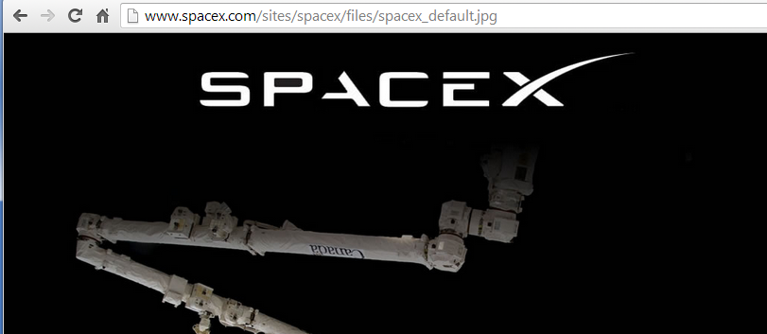
How do I get an image URL?
1
2
3
4
Copy this

Slide 45
Challenge: create an image link (hint: use nesting!)

Slide 46
Unordered Lists
<ul>
<li> list item 1 </li>
<li> list item 2 </li>
</ul>

Slide 47
Ordered Lists
<ol>
<li> list item 1 </li>
<li> list item 2 </li>
</ol>

Slide 48
Remember to save!

Slide 49
Lunch!

Slide 50
CSS time!
Let’s make everything beautiful.

Slide 51
CSS: cascading style sheets
Just like HTML, CSS is a language that communicates with browsers
It makes HTML look pretty!

Slide 52
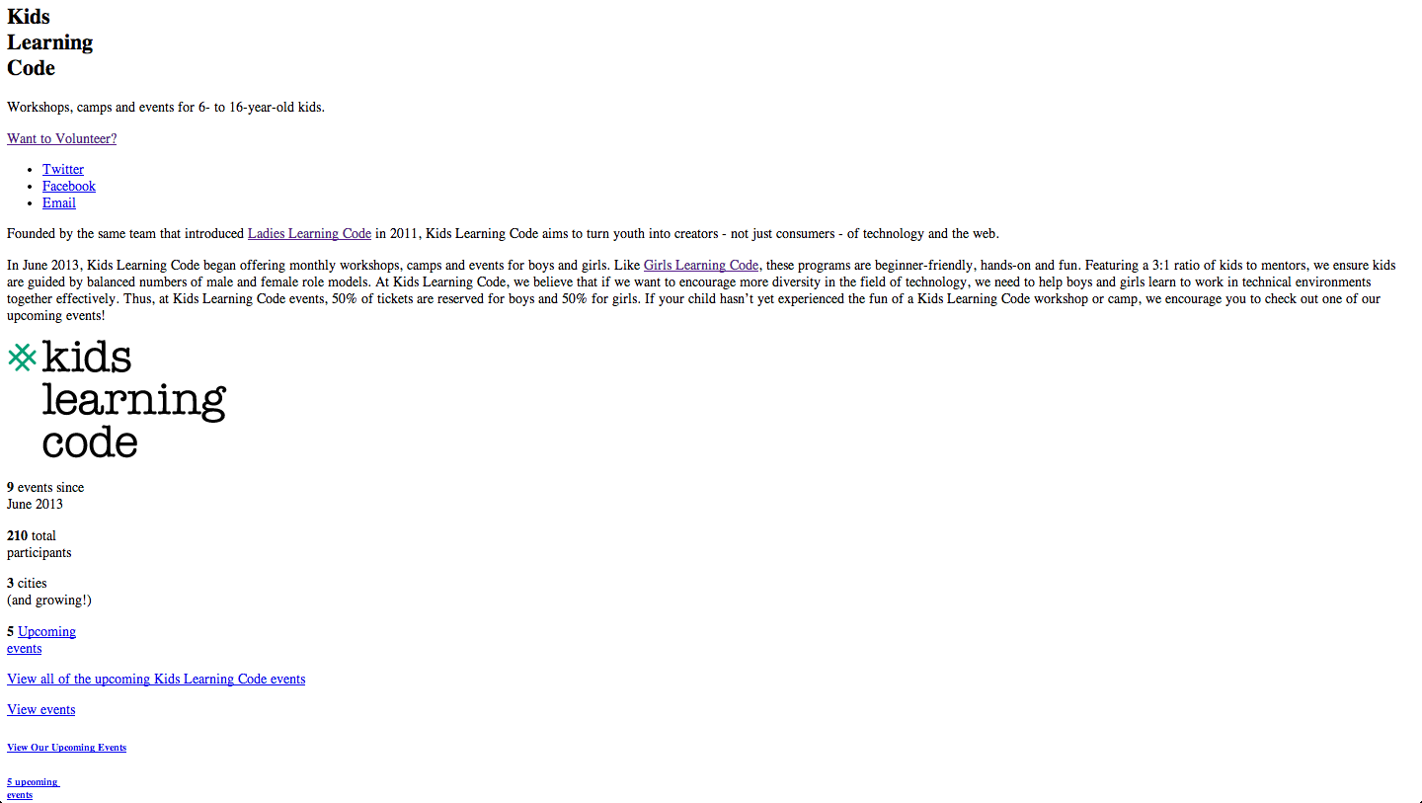
A webpage without CSS

Slide 53
A webpage with CSS

Slide 54
Use HTML for the content.
Use CSS for the design.
Headings
Paragraphs
Images
Links
Lists
Colors
Fonts
Backgrounds
Borders
Sizes

Slide 55
Where do we put CSS?
<html>
<head>
</head>
<body>
<style>
</style>
</body>
</html>
We’re going to start communicating in HTML
Information about our webpage starts here
Information about our website ends here
Content to display starts here
We’re going to start communicating in CSS
We’re going to stop communicating in CSS
Content to display ends here
We’re going to stop communicating in HTML

Slide 56
CSS is made up of rules
HTML elements have to follow these rules in order to look pretty!

Slide 57
CSS rules use { and } and ;

Slide 58
CSS rules
<style>
p {
color: red;
}
</style>
selector
value
property

Slide 59
What do these do?
<style>
h1 {
text-align: center;
color: blue;
}
</style>
<style>
h3, h4 {
font-weight: bold;
font-size: 18px;
}
</style>
#1
#2

Slide 60
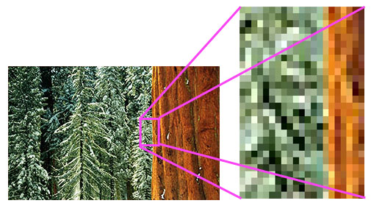
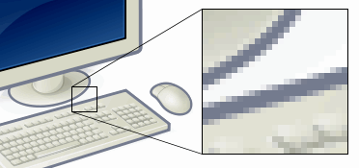
What exactly is a pixel?
A unit of measure for your computer screen

Slide 61


Colour
p {
color: orange;
}
But how can we get other shades of orange?
? ? ? ? ?

Slide 62

HEX Codes
To access them, we can use something called a hex code. A hex code is a made up of 6 numbers or letters and is just another way of saying a specific color
We use the # sign before our 6 digits to tell our browser we are referring to a hex code
Example: #A8AFFF =

Slide 63
Hex Codes
Try adding your using own hex code using http://www.colorpicker.com

Slide 64
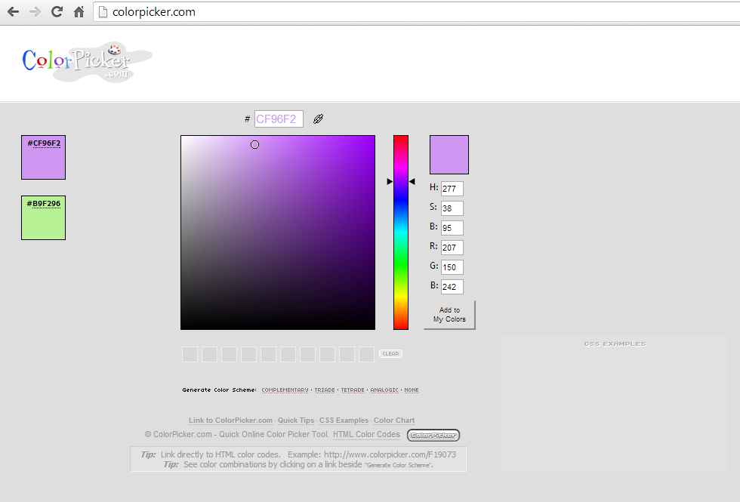

Slide 65
Web-safe fonts
There are a number of font families that are considered "web safe.”A few of them are: Arial, Impact, Georgia, Courier, Monaco, Geneva
Full list here: http://cssfontstack.com

Slide 66
Now… back to HTML
Remember: HTML goes inside the body tags, but not
inside the style tags! (that’s for CSS)

Slide 67
<section> </section>
HTML has a neat little tag called section
On it’s own, it doesn’t actually do anything. But when used with CSS, you can style sections of your webpage

Slide 68
class
To make a section unique and styleable, we add something called a class. The name of the class can be anything, but should represent what you’re about to style
Here’s an example of how we could style all of our content (paragraphs, pictures, etc.) together:
<section class = “container”>

Slide 69
Styling the class
Now that the HTML is all set up, nothing actually happened right? That’s because we haven’t added any CSS yet!
In between the style tags, we can add:
.container {
}
“.” means class!

Slide 70
Cool CSS properties
color: #999999;
font-size: 18px;
font-family: ‘Comic Sans MS’;
font-weight: 100;
font-style: italic;
text-transform: uppercase;
text-shadow: 1px 1px 2px red;
text-align: center;
line-height: 26px;
text-decoration: underline;
padding: 10px 15px 12px 10px;
padding-top: 15px;
margin: 15px 5px 15px 10px;
margin-top: 5px;
opacity: 0.5;
border: 5px solid #FF0000;
border-bottom: 1px dashed #DDDDDD;
border-left: 2px dotted #00000;
border-radius: 5px;
box-shadow: 1px 1px 2px red;
box-shadow: 1px 1px 2px rgba(0, 0, 0, 0.1);
background-color: #FFFFFF;
background-image: url('http://...');
background: linear-gradient(to bottom,
#FF0000 0%,#0000FF 100%);
height: 10px;
width: 20px;
display: block;
margin: 0 auto;

Slide 71
Congratulations!!
You’ve made your first webpage!
Be sure to click “Publish” in the top right hand corner and share the URL with your friends and family

